Slide 1
Length of the hypotenuse
Geometrical properties: similarity and Pythagoras’ theorem

Slide 2
how to use Oak lessons

Slide 3
I can use Pythagoras’ theorem to find the length of the hypotenuse.

Slide 4
A right-angled triangle has exactly one 90° interior angle.
A hypotenuse is the side of the right-angled triangle which is opposite the right-angle.
Pythagoras’ theorem shows that the sum of the squares of the two shorter sides of a right-angled triangle is equal to the square of its longest side (the hypotenuse).

Slide 5

Length of the hypotenuse
Squares from the sides of a triangle
Pythagoras’ theorem to find the hypotenuse

Slide 6
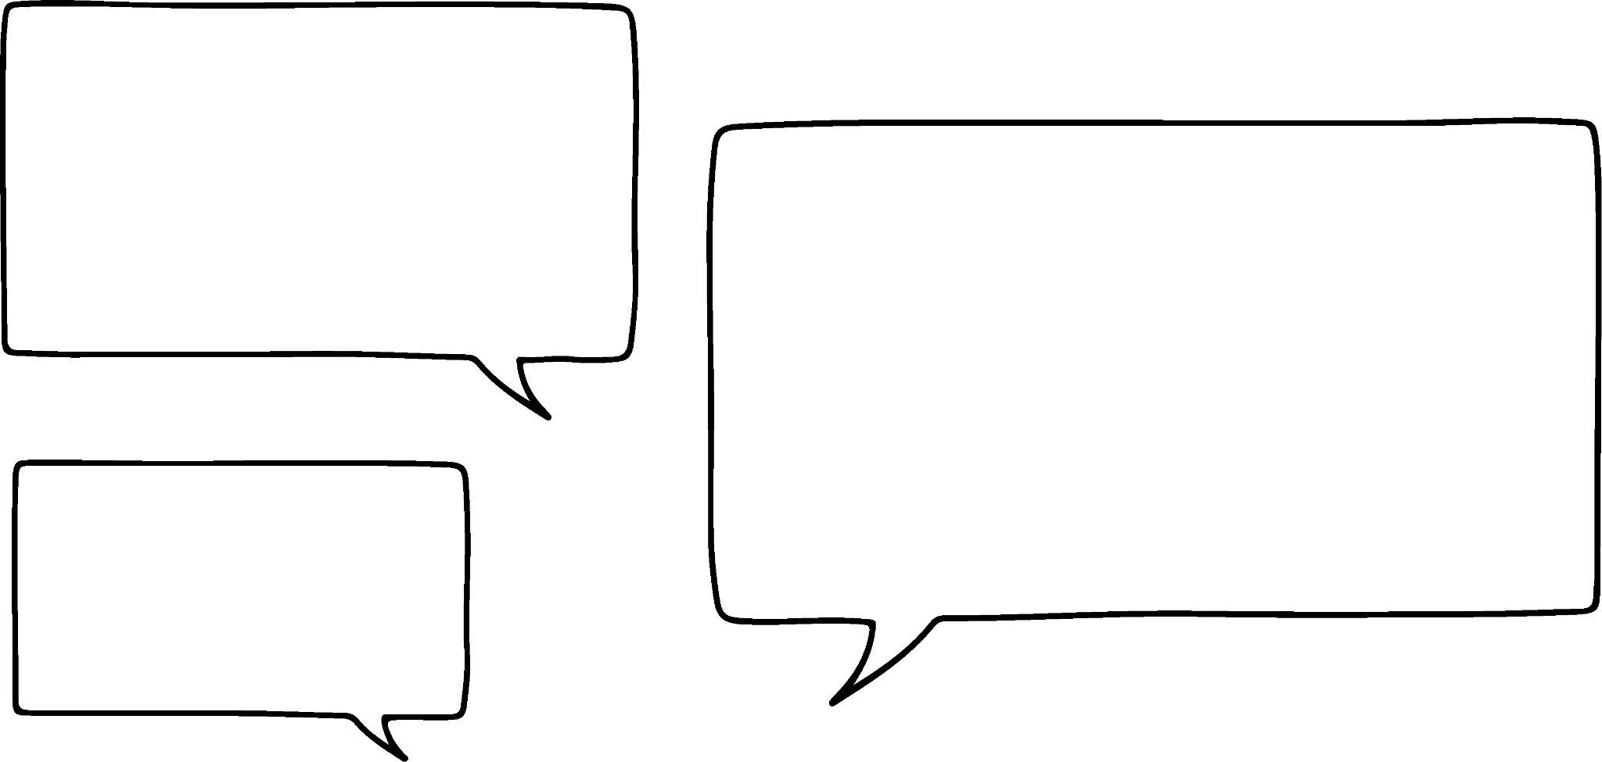


Squares from the sides of a triangle
I remember that you can join three squares at their vertices to create a triangle.
Aisha
That’s great, but why did this one make a right-angled triangle?
Andeep

Slide 7

Squares from the sides of a triangle
The areas of the smaller two squares had to equal the area of the largest square.
5 cm
10 + 15
cm²
25 cm²
10 cm²
Aisha
That’s great, but why did this one make a right-angled triangle?
Oh, and we can square root the area of a square to find its length!
15 cm²
Andeep

Slide 8
Squares from the sides of a triangle
Which means that 5 cm is also the length of the longest side of that triangle.
25 cm²
5 cm
Aisha
hypotenuse
The hypotenuse is easy to spot… It’s always the side opposite the right angle!
Longest side of the triangle?
I think that’s called the hypotenuse.
Andeep

Slide 9
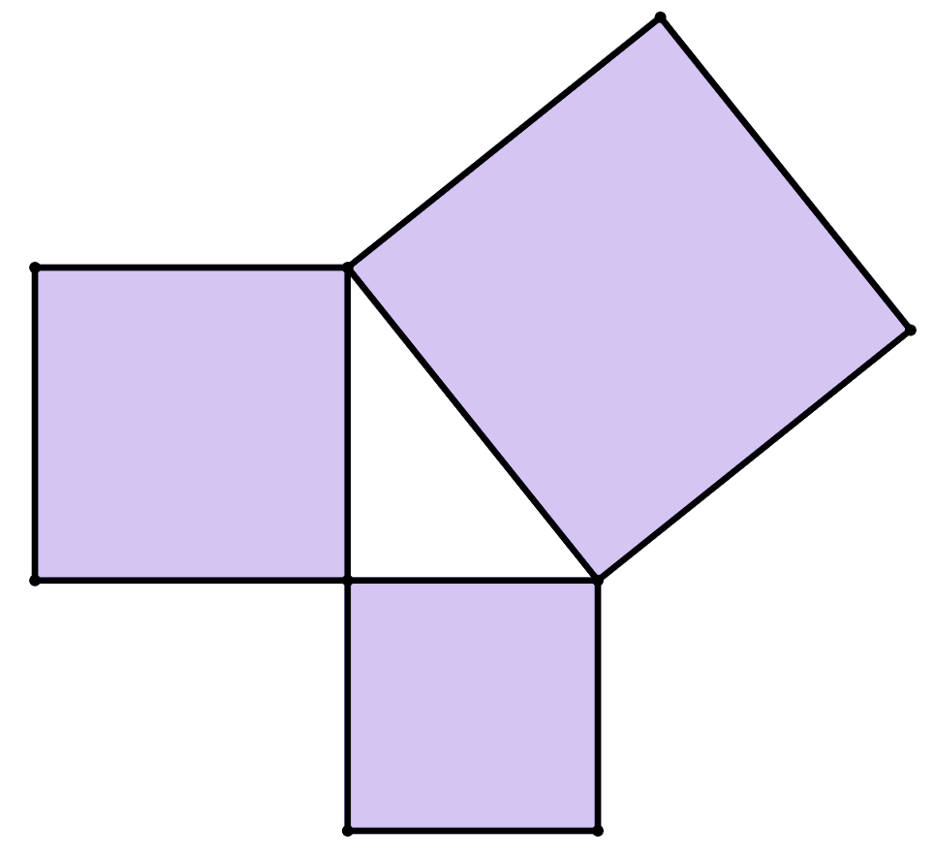


Squares from the sides of a triangle
Which of these statements is correct?
a
The square with largest area is always opposite the right angle.
square C
square A
b
The square with largest area is always to the right of the triangle.
c
The hypotenuse of the triangle always touches the right angle.
square B
d
The hypotenuse of the triangle is always the longest side of the triangle.

Slide 10

Squares from the sides of a triangle
I wonder if I can still find the length of the hypotenuse if I have the triangle, but not all the squares?
h cm
Andeep
6 cm
Sure you can.
You can just draw on any squares you don’t have.
8 cm
Sam

Slide 11

Squares from the sides of a triangle
If we know the two shorter sides we can draw on the squares and find their areas.
area
36 + 64 cm²
100 cm²
The length of the hypotenuse is the same as the side of the largest square.
To find the length of the hypotenuse square root the area of the largest square.
10 cm
h cm
6 cm
area
36 cm²
6 cm
8 cm
100
= 10
The hypotenuse is 10 cm long.
area
64 cm²

Slide 12
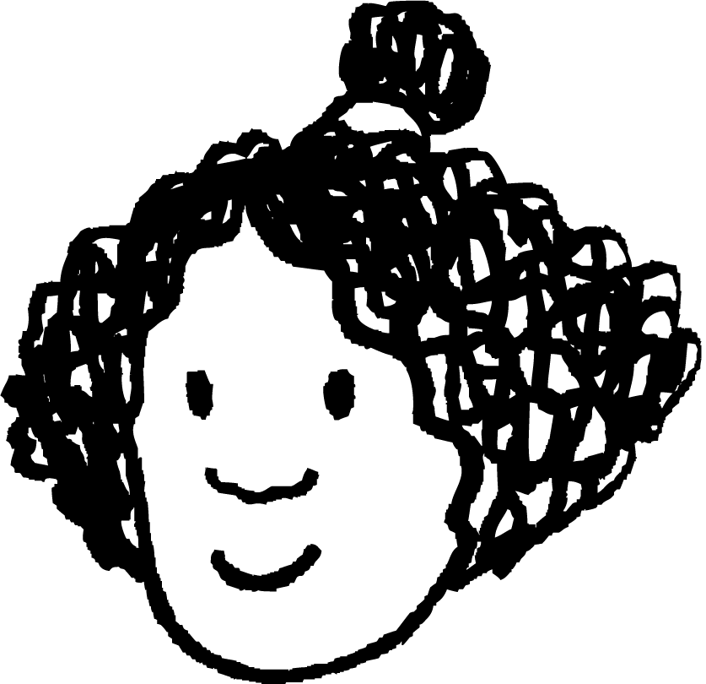
Squares from the sides of a triangle
Izzy draws a square with a side shared by the 9 cm side of the triangle.
What is the area of this square?
area
40 cm²
Izzy then draws a square with a side shared by the hypotenuse of the triangle.
area
121 cm²
11 cm
What is the area of this square?
9 cm
What is the length of the hypotenuse of this triangle?
area
81 cm²
121
= 11
The hypotenuse is 11 cm long.

Slide 13
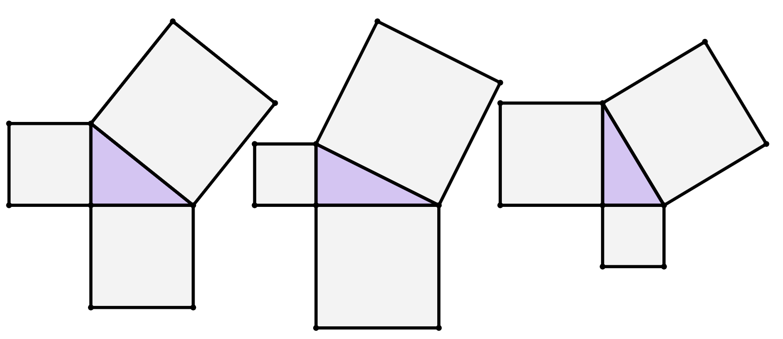
Squares from the sides of a triangle
1) Find the area of each square.
b)
a)
c)
area
30 cm²
3 cm
area
42 cm²
area
15 cm²
1 cm
6 cm

Slide 14
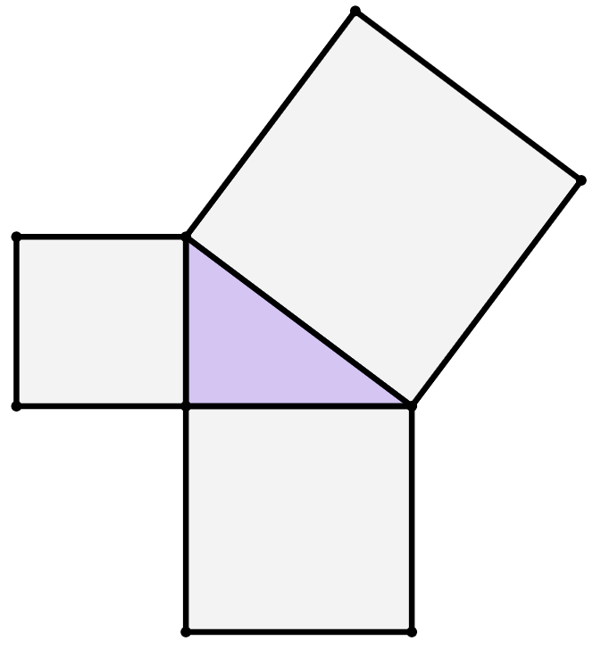
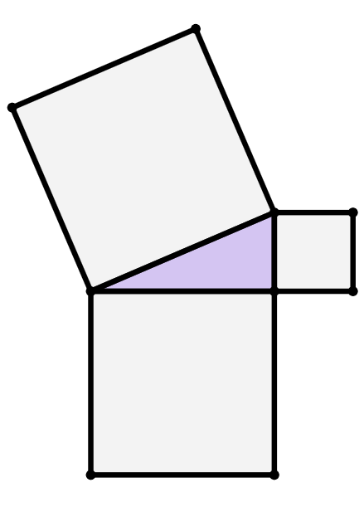
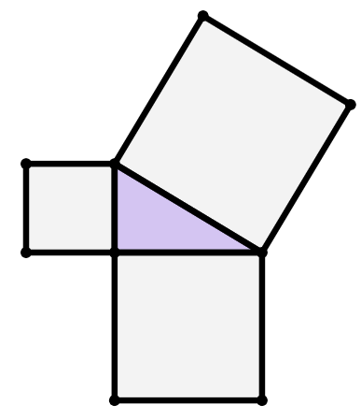
Squares from the sides of a triangle
2) Find the length of the hypotenuse of each triangle.
c)
a)
b)
area
41 cm²
9 cm
12 cm
10 cm
area
103 cm²
area
69 cm²

Slide 15
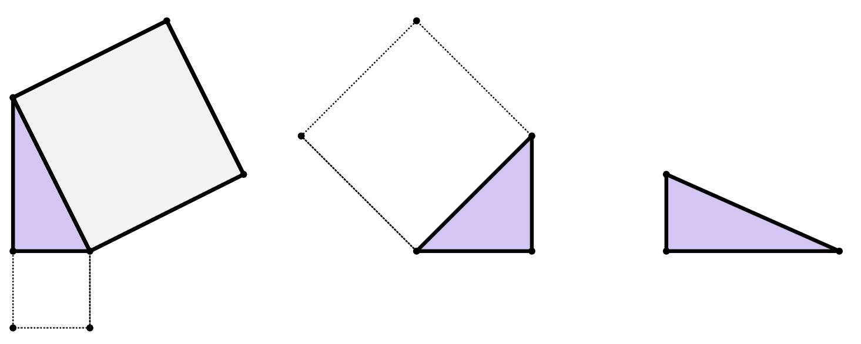
Squares from the sides of a triangle
3) By drawing on any missing squares first and calculating their areas, find the length of the hypotenuse of each triangle.
7 cm
a)
24 cm
20 cm
21 cm
18 cm
b)
c)
area
76 cm²

Slide 16
Squares from the sides of a triangle
1) Find the area of each square.
b)
a)
c)
72 cm²
51 cm²
10 cm²
9 cm²
area
30 cm²
3 cm
1 cm²
area
42 cm²
36 cm²
area
15 cm²
1 cm
6 cm

Slide 17
Squares from the sides of a triangle
2) Find the length of the hypotenuse of each triangle.
c)
a)
b)
hypotenuse
13 cm
area
144 cm²
area
144 cm²
area
81 cm²
area
41 cm²
9 cm
12 cm
hypotenuse
12 cm
area
100 cm²
area
225 cm²
10 cm
area
169 cm²
area
103 cm²
hypotenuse
15 cm
area
69 cm²

Slide 18
Squares from the sides of a triangle
3) By drawing on any missing squares first and calculating their areas, find the length of the hypotenuse of each triangle.
49 cm²
576 cm²
7 cm
a)
400 cm²
441 cm²
area
400 cm²
24 cm
20 cm
21 cm
hypotenuse
25 cm
hypotenuse
20 cm
b)
area
841 cm²
c)
18 cm
area 625 cm²
324 cm²
hypotenuse
29 cm
area
76 cm²

Slide 19
Length of the hypotenuse
Squares from the sides of a triangle
Pythagoras’ theorem to find the hypotenuse

Slide 20
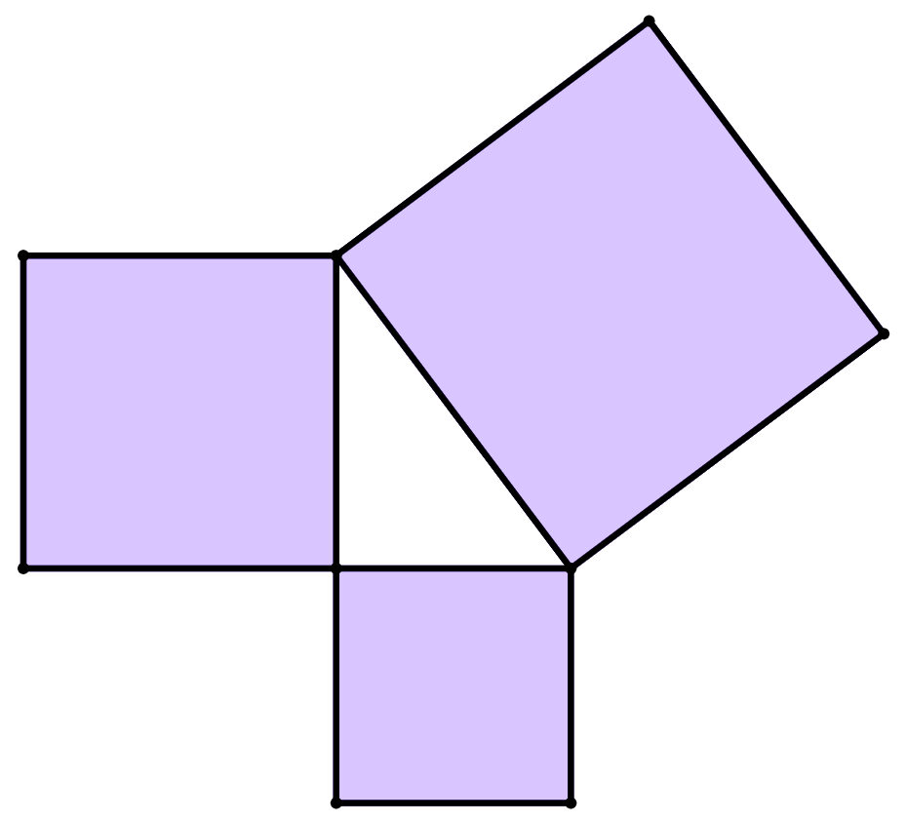
Pythagoras’ theorem to find the hypotenuse
I remember that Pythagoras’ theorem can be used to find side lengths of a right-angled triangle.
I think Pythagoras’ theorem can be written in several different ways.
square
C
Sam
square
A
area of square A
+
area of square B
=
area of square C
c units
a units
length of side a squared
+
length of side b squared
=
length of side c squared
square B
b units
Pythagoras’ theorem: a² + b² = c²

Slide 21
Pythagoras’ theorem to find the hypotenuse
We can find the length of the hypotenuse of a right-angled triangle in two ways:
Calculating the areas of the squares attached to each of the three sides of the triangle.
Either with or without drawing the squares on.
Algebraically, by substituting lengths of the triangle into the Pythagoras’ theorem formula:
a² + b² = c²
Where a and b are the two shorter sides of the triangle, and c is the hypotenuse of the triangle.

Slide 22
Pythagoras’ theorem to find the hypotenuse
Finding areas of squares
The Pythagoras’ theorem formula
On a right-angled triangle, if you:
square the two shorter sides
add the results together
the result is the square of the
hypotenuse
a² + b² = c²
18² + 30² = c²
324 + 900 = c²
1224 = c²
1224 cm²
324 + 900
hypotenuse
18 cm
324
18²
30 cm
900
30²

Slide 23

Pythagoras’ theorem to find the hypotenuse
Finding areas of squares
The Pythagoras’ theorem formula
In this example, 1224 represents the area of the square at the hypotenuse.
To find the length of the hypotenuse itself, square root 1224.
a² + b² = c²
18² + 30² = c²
324 + 900 = c²
1224 = c²
1224 = c²
1224
= 34.985711
1224 cm²
hypotenuse
34.985711
= c
34.99 cm
18 cm
c is the hypotenuse, which is 34.99 cm when rounded.
30 cm

Slide 24
Pythagoras’ theorem to find the hypotenuse
Fill in the blanks of the method to find the hypotenuse of this right-angled triangle using Pythagoras’ theorem.
18.03 cm
c cm
2
2
2
10 cm
10
+
15
=
c
100
+
225
=
c²
15 cm
325
=
c²
18.03
=
c

Slide 25
Pythagoras’ theorem to find the hypotenuse
The Pythagoras’ theorem formula
I wonder if there’s a quicker way to calculate the length of the hypotenuse using Pythagoras’ theorem by using a calculator differently?
a² + b² = c²
18² + 30² = c²
324 + 900 = c²
1224 = c²
1224 = c²
Sam
34.985711
= c
hypotenuse
34.99 cm
c is the hypotenuse, which is 34.99 cm when rounded.
18 cm
30 cm

Slide 26
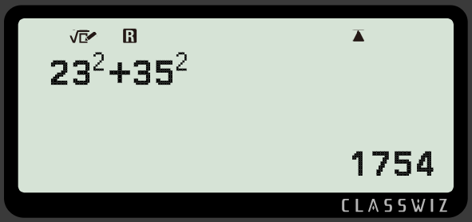

Pythagoras’ theorem to find the hypotenuse
Pythagoras’ theorem: a² + b² = c²
a and b are the lengths of the shorter sides of the triangle (which are the legs of the right angle).
hypotenuse
23 cm
1754 is the value of c², the area of the square at the hypotenuse.
35 cm
buttons to press
calculator screen

Slide 27
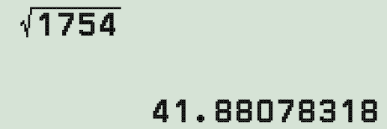

Pythagoras’ theorem to find the hypotenuse
Pythagoras’ theorem: a² + b² = c²
To find the value of c, the length of the hypotenuse, you need to square root 1754.
hypotenuse
23 cm
So, 41.88 cm is the length of the hypotenuse.
41.88 cm
35 cm
buttons to press
calculator screen

Slide 28

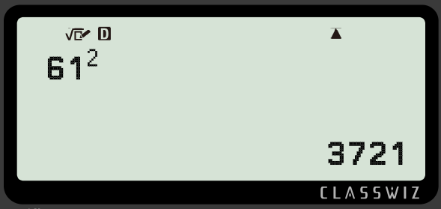


Pythagoras’ theorem to find the hypotenuse
Whose first calculation to find the hypotenuse of this triangle is correct?
hypotenuse
11 cm
50 cm
Lucas
Jun

Slide 29
Pythagoras’ theorem to find the hypotenuse
What might Jun have done wrong in their method?
hypotenuse
11 cm
Jun incorrectly added together the two shorter sides before squaring.
This is the incorrect order of operations.
50 cm
Jun

Slide 30
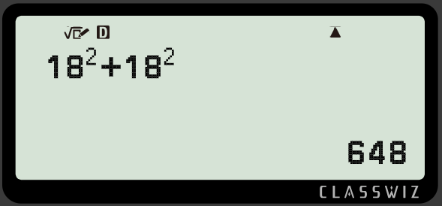

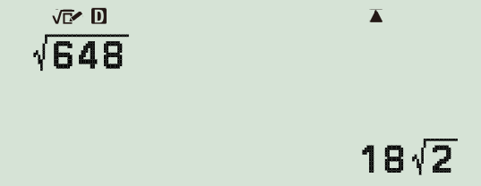

Pythagoras’ theorem to find the hypotenuse
Sometimes, you may have to change the format of your answer so that the hypotenuse is a length given as a decimal.
hypotenuse
18 cm
18 cm
This is called surd form.
We want to change its format to decimal form.

Slide 31

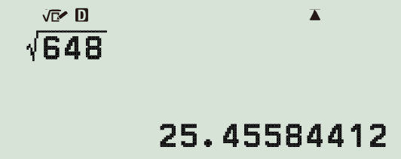


Pythagoras’ theorem to find the hypotenuse
Sometimes, you may have to change the format of your answer so that the hypotenuse is a length given as a decimal.
hypotenuse
25.5 cm
18 cm
18 cm
This is now the decimal form for the length of the hypotenuse, which we can round to 1 decimal place.

Slide 32
Pythagoras’ theorem to find the hypotenuse
Find the hypotenuse of this right-angled triangle. Give your answer in decimal form accurate to 1 decimal place.
hypotenuse
20 cm
20² + 24² = 976
24 cm
976 = 4 61
hypotenuse = 31.2 cm (1 d.p.)

Slide 33
Pythagoras’ theorem to find the hypotenuse
1) This is a right-angled triangle.
Pythagoras’ theorem can be written as c² = a² + b², where c is the hypotenuse of the triangle.
Fill in the blanks to complete the Pythagoras’ theorem equation for this triangle.
hypotenuse
61 cm
11 cm
10 cm
14 cm
60 cm
2) Show that the hypotenuse of this triangle is 17.2 cm (1 d.p.)
2
+
2
2
=
2
+
2

Slide 34
Pythagoras’ theorem to find the hypotenuse
3) Match each triangle to its corresponding square of the hypotenuse and length of the hypotenuse.
b)
a)
5 cm
hypotenuse
c)
11 cm
2 cm
7 cm
13 cm
hypotenuse
10 cm
d
e
f
square of the hypotenuse
146 cm²
173 cm²
149 cm²
length of the hypotenuse
(1 d.p.)
h
g
13.2 cm
i
12.2 cm
12.1 cm

Slide 35
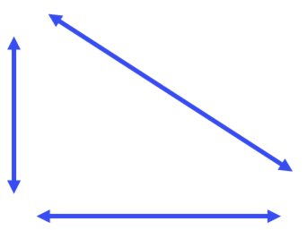
Pythagoras’ theorem to find the hypotenuse
4) All these triangles have two lengths that sum to 64 cm.
Starting with the shortest, put the hypotenuses of the triangles in order of length.
a)
c)
43 cm
hypotenuse w
32 cm
21 cm
hypotenuse y
32 cm
b)
d)
hypotenuse z
hypotenuse x
28 cm
54 cm
36 cm
10 cm

Slide 36
Pythagoras’ theorem to find the hypotenuse
1) This is a right-angled triangle.
Pythagoras’ theorem can be written as c² = a² + b², where c is the hypotenuse of the triangle.
Fill in the blanks to complete the Pythagoras’ theorem equation for this triangle.
61
2
=
60
2
+
11
2
61 cm
11 cm
or
60 cm
61
2
=
11
2
+
60
2

Slide 37
Pythagoras’ theorem to find the hypotenuse
hypotenuse
10
2
+
14
2
= 296
10 cm
14 cm
296 = 2 74 = 17.20465…
2) Show that the hypotenuse of this triangle is 17.2 cm (1 d.p.)
hypotenuse = 17.2 cm

Slide 38
Pythagoras’ theorem to find the hypotenuse
3) Match each triangle to its corresponding square of the hypotenuse and length of the hypotenuse.
b)
a)
5 cm
12.2 cm
c)
11 cm
2 cm
7 cm
13 cm
12.1 cm
10 cm
f
d
149 cm²
173 cm²
146 cm²
e
h
i
13.2 cm
g
12.1 cm
12.2 cm

Slide 39
Pythagoras’ theorem to find the hypotenuse
4) All these triangles have two lengths that sum to 64 cm.
Starting with the shortest, put the hypotenuses of the triangles in order of length.
a)
hypotenuse w
hypotenuse w = 45.25 cm
32 cm
32 cm
b)
hypotenuse x
28 cm
hypotenuse x = 45.61 cm
36 cm

Slide 40
Pythagoras’ theorem to find the hypotenuse
4) For each of these triangles, the sum of the lengths of the two shorter sides is equal, at 64 cm each.
Starting with the shortest, put the hypotenuses in order of length.
c)
43 cm
hypotenuse y = 47.85 cm
21 cm
hypotenuse y
d)
hypotenuse z
hypotenuse z = 54.92 cm
54 cm
10 cm

Slide 41
Pythagoras’ theorem to find the hypotenuse
4) For each of these triangles, the sum of the lengths of the two shorter sides is equal, at 64 cm each.
Starting with the shortest, put the hypotenuses in order of length.
The correct order was
w → x → y → z
The bigger the difference between the two shorter side lengths, the larger the hypotenuse became.

Slide 42
Length of the hypotenuse
The area of two squares with side lengths at the two shorter sides of a right-angled triangle are equal in area to the square at the hypotenuse of the same triangle.
The Pythagoras’ theorem formula (usually seen as a² + b² = c², where c is the length of the hypotenuse) can be used to calculate the length of the hypotenuse of a right-angled triangle, given the two shorter lengths of the triangle.
There are efficient ways of calculating the hypotenuse of a right-angled triangle using Pythagoras’ theorem on a calculator.

Slide 43

© Oak National Academy 2024.
Produced in partnership with Mathematics in Education and Industry.
Licensed on the Open Government Licence v3.0, except where otherwise stated. See Oak terms and conditions.

